Slide 1
Introduction to DBMS

Slide 2
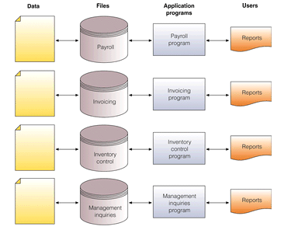
The Traditional Approach To Data Management
Create new files for each application
Data redundancy
Data integrity

Slide 3
Disadvantages of File Processing
Program-Data Dependence
All programs maintain metadata for each file they use
Data Redundancy (Duplication of data)
Different systems/programs have separate copies of the same data
Limited Data Sharing
No centralized control of data
Lengthy Development Times
Programmers must design their own file formats
Excessive Program Maintenance
80% of information systems budget

Slide 4
DATABASE Definition
Data : These are the known facts that can recorded and that have implicit meaning
Ex : item codes , book titles, phone numbers etc.
Database : It is a collection of related data
Ex : names , telephone numbers, addresses, age etc.

Slide 5
DBMS Definition
It is a general purpose software system that facilitates the processes of
Defining
Constructing
Manipulating
Sharing
databases among various users and applications.

Slide 6
DBMS Definition Contd..
Defining : It involves specifying data types, structures and constraints for the data to be stored in the database.
Constructing : It is the process of storing the data itself on some storage medium that is controlled by DBMS.

Slide 7
DBMS Definition Contd..
Manipulating : It includes functions such as querying the database to retrieve specific data , updating the database to reflect changes in mini world and generating reports from the data.
Sharing : It allows multiple users and programs to access the database concurrently.

Slide 8
Advantages of DBMS
Controlling redundancy
Reduce Inconsistency
Providing storage structure for efficient query processing.
Restricting unauthorized users.
Providing concurrency.
Providing backup and recovery.
Enforcing integrity constraints.

Slide 9
Roles in DBMS Environment
Database Administrators
Database Designers
End Users
System Analysts
Application programmers

Slide 10
Roles in DBMS Environment Contd..
Database Administrators
Administering resources in DB environment like database, DBMS and related software.
Responsible for authorizing access to database , for coordinating and monitoring its use.
Accountable for problems such as breach of security or poor response time.

Slide 11
Roles in DBMS Environment Contd..
Database Designers
To identify the data to be stored in DB and for choosing appropriate structures
Should communicate with all prospective DB users in order to understand their requirements and come up with a design.
Develop views of DB that meets processing needs of different groups . Each view is then analyzed and integrated with views of other groups.

Slide 12
Roles in DBMS Environment Contd..
End users
Casual End Users : Occasionally access the DB but they may need different information each time. They are typically Top or middle level managers
Naive End Users : These are most frequent users of DB who will be constantly querying and updating the DB. Ex: bank tellers, Reservation clerks etc..
Sophisticated End users: Includes engineers ,scientists ,business analysts use the facilities of DBMS so as to implement their applications to meet complex requirements.
Stand alone users : maintain personal DB by using ready made packages Ex: Tax package that stores variety of financial data for tax purpose.

Slide 13
Roles in DBMS Environment Contd..
System Analyst : Determine the requirements of end users, and develop specifications for canned transactions that meet these requirements.
Application Programmer : Implement these specifications as programs. Then they Test , debug , document and maintain these transactions. These should be familiar with the full range of capabilities provided by DBMS to accomplish their tasks.

Slide 14
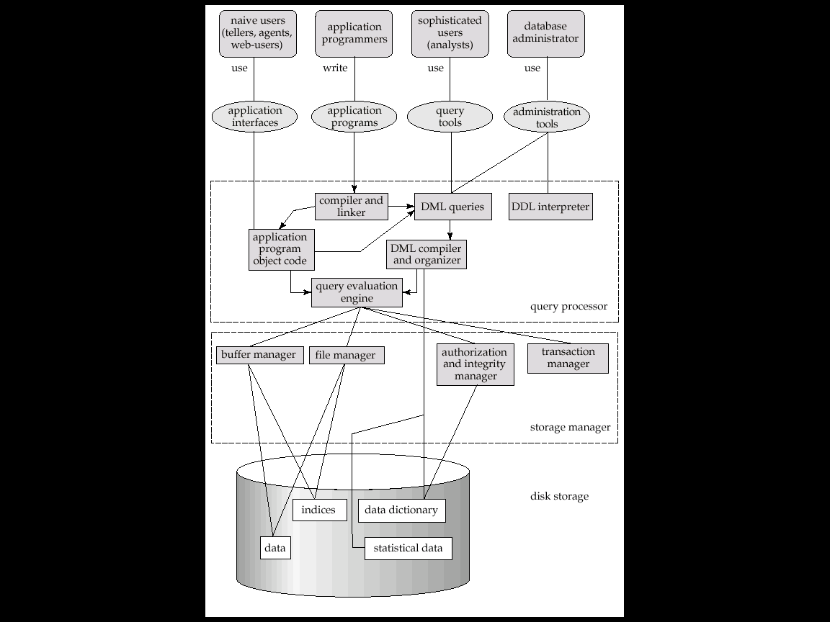
Overall System Structure

Slide 15
Overall System Structure
A database system is partitioned into modules which handles different responsibilities of over all system.
The functional components of a database system are
Query processor Component
Storage manager component

Slide 16
Query Processor Component
DML Compiler : It translates DML statements into a lower level instructions that the query evaluation engine understands
Embedded DML precompiler : It converts DML statements embedded in an application program into normal procedure calls in the host language.
DDL Interpreter : It interprets DDL statements and records them in a set of tables
Query evaluation engine : It executes lower level instructions generated by the DML compiler

Slide 17
Storage manager component
It is an Interface between the data stored in the database and the application programs and queries submitted to the system.
Authorization and Integrity manager : It tests for satisfaction of integrity constraints and checks the authority of users to access data.
Transaction Manager : It ensures concurrent transaction executions processed without conflicting.
File manager : It manages the allocation of space on disk and the data structures used to represent information.
Buffer manager : Which is responsible for fetching data from disk storage into main memory.

Slide 18
Database terminology
Schema
.
Database Schema
The description of a database.
Includes descriptions of the database structure
data types and the constraints on the database.
Schema Diagram
An illustrative display of (most aspects of)database schema
Schema Construct
A component of the schema or an object within the schema, e.g., STUDENT, COURSE

Slide 19
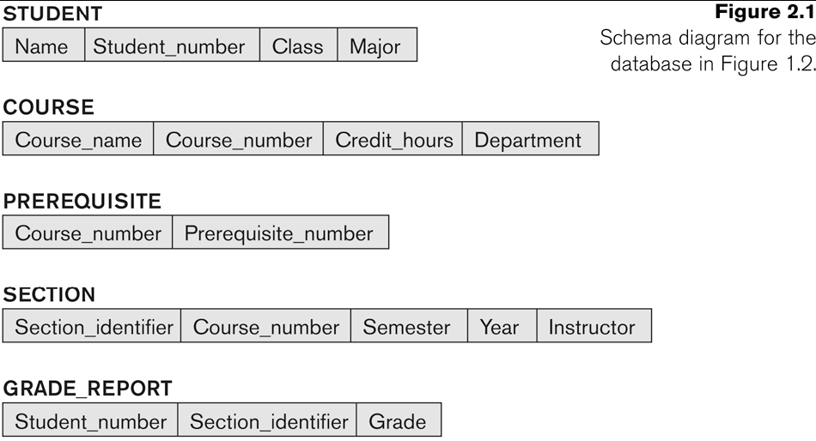
Example of a Database Schema

Slide 20
Database State
The actual data stored in a database at a particular moment in time. This includes the collection of all the data in the database.
Also called database instance (or occurrence or snapshot).
The term instance is also applied to individual database components, e.g. record instance, table instance, entity instance

Slide 21
Database State Contd..
Database State:
Refers to the content of a database at a moment In time.
Initial Database State:
Refers to the database state when it is initially loaded into the system.
Valid State:
A state that satisfies the structure and constraints of the database.

Slide 22
Database Schema vs. Database State
.
Distinction
The database schema changes very infrequently.
The database state changes every time the database is updated.
Schema is also called intension.
State is also called extension

Slide 23
3 schema Architecture
Proposed to support DBMS characteristics of:
Program-data independence.
Support of multiple views of the data.
Not explicitly used in commercial DBMS products, but has been useful in explaining database system organization

Slide 24
3 schema Architecture Contd..
Defines DBMS schemas at three levels:
Internal schema at the internal level to describe physical
storage structures and access paths (e.g. indexes).
Typically uses a physical data model.
Conceptual schema at the conceptual level to describe the
structure and constraints for the whole database for a
community of users.
uses a conceptual or an implementation data model.
External schemas at the external level to describe the
various user views.
Usually uses the same data model as the conceptual schema.

Slide 25
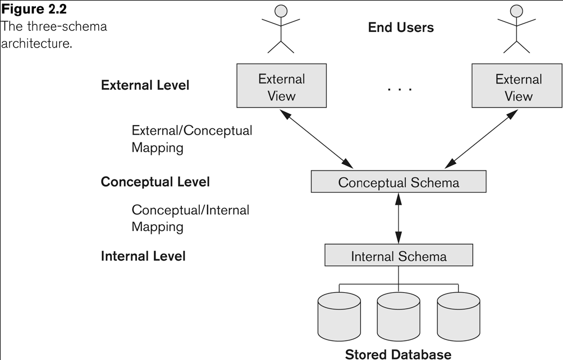
3 schema Architecture Contd..

Slide 26
3 schema Architecture Contd..
Mappings among schema levels are needed to transform requests and data.
Programs refer to an external schema, and are mapped by the DBMS to the internal schema for execution.
Data extracted from the internal DBMS level is reformatted to match the user’s external view (e.g. formatting the results of an SQL query for display in a Web page)

Slide 27
Data Independence
Logical Data Independence:
The capacity to change the conceptual schema without having to change the external schemas and their associated application programs.
Physical Data Independence:
The capacity to change the internal schema without having to change the conceptual schema.
For example, the internal schema may be changed when certain file structures are reorganized or new indexes are created to improve database performance

